Slide 2
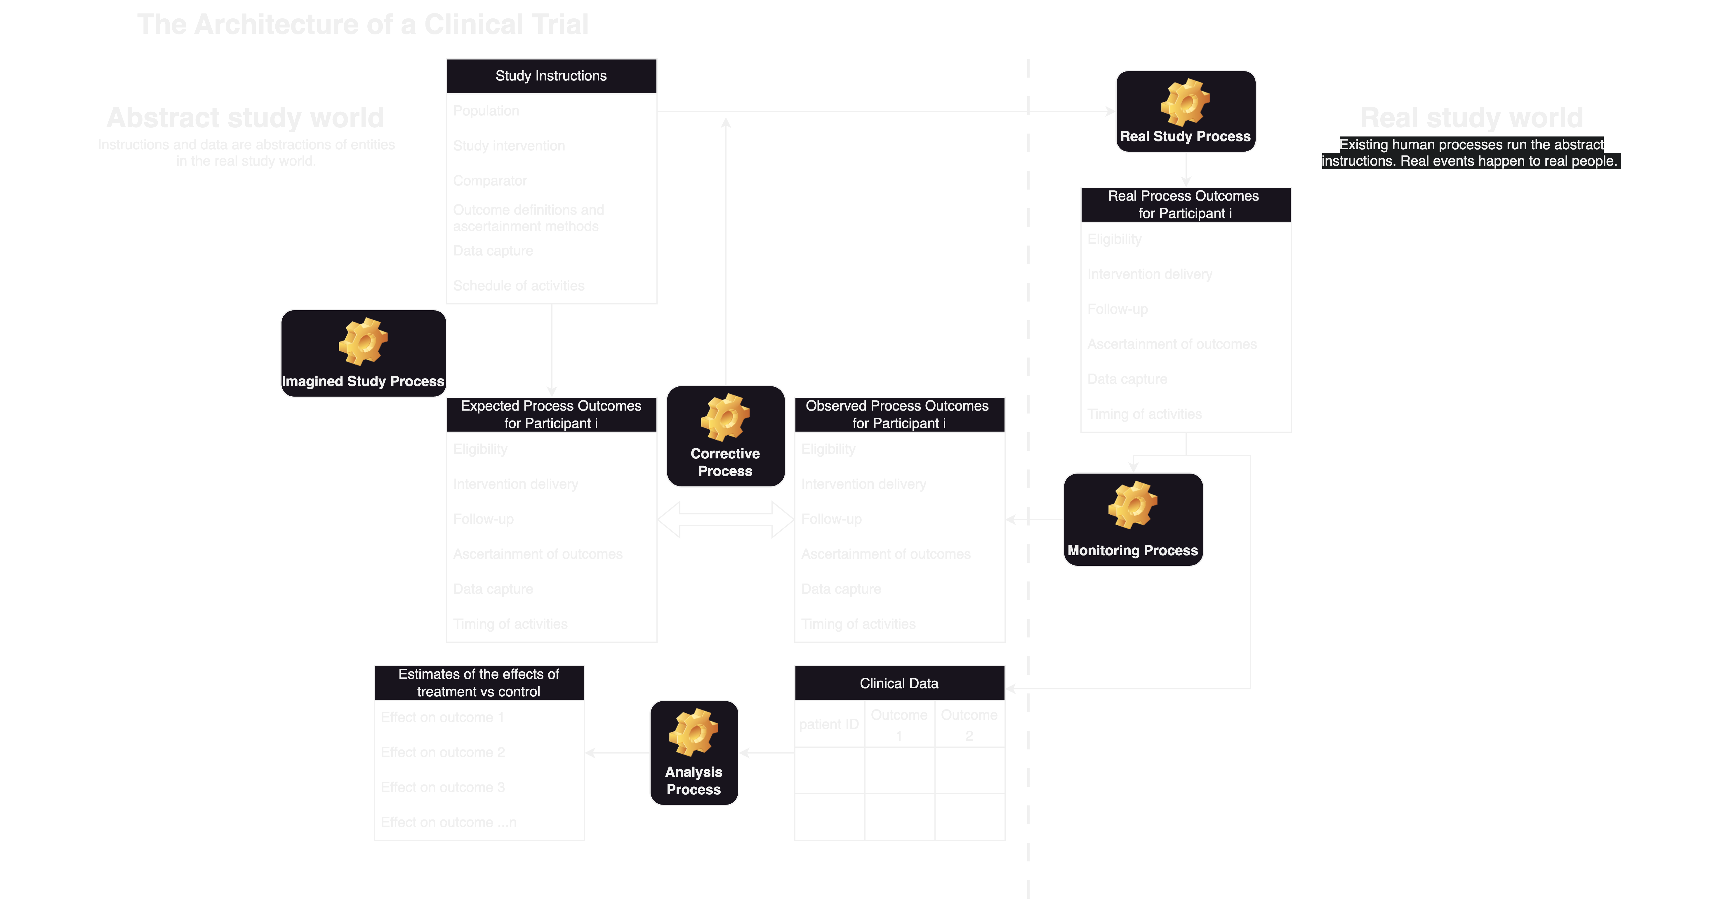

Slide 9


Slide 10
Thinking about monitoring and correction
Enrolment is just the beginning of a process through which a patient contributes information about treatment effects
There are years of necessary additional activities by local healthcare providers/study teams
Continue to deliver the allocated therapy as appropriate
Completion of assessments
Ascertainment of study outcomes
Recording of study data
Responding to patient queries
Responding to requests by the data coordinating centre, REB, regulators, etc…

Slide 11
Thinking about monitoring and correction
Types of monitoring
Internal monitoring of processes by the study team/sponsor
Independent monitoring of processes and treatment effects by the DMC
Monitoring of adverse events by study team/sponsor, REB, DMC, and regulatory agencies (when applicable).

Slide 12
Thinking about monitoring and correction
The real world execution of a study is never the same as the intended execution.
The magnitude of the difference has implications for
The real effects on the health of real patients
The extent to which we can estimate the real effects on the health of real patients using measured study outcomes (abstractions of real events)
These abstractions only approximate real events.
To minimize the difference, we create
Monitoring processes to detect deviations
Corrective processes to change the study instructions (protocol, manual of operations) or how they are being executed by local investigators and staff

Slide 13
Thinking about monitoring and correction
The ability to issue corrections depends on the quality of the monitoring process
We decide what is important to monitor
Participant enrolment
Identification
Consent procedures
Adherence to the eligibility criteria
Randomization
Enrolment rate
Intervention initiation
Ongoing intervention delivery
Not running hemodiafiltration
Adverse events
Study outcomes

Slide 14
Thinking about monitoring and correction
Is this ”pragmatic”?
Consider the distinction between efforts to enforce adherence to study procedures and efforts to enforce adherence to treatment procedures
Study procedures:
Enrolment (including the adherence to consent procedures)
Follow-up
Participant protections
Good outcome ascertainment
Maximizing these things does not compromise generalizability.
A sloppy study is tremendously harmful because you do not find out the truth and you compromise trust in the research enterprise.

Slide 15
Thinking about monitoring and correction
Is enforcing adherence to treatment procedures pragmatic?
Yes, if the purpose is to make the world inside the study work more like the world outside the study.
We are justified in strong efforts to maximize adherence to the allocated dialyzers in DIALEX because the opportunity for nonadherence is largely artificial: it does not extend to the real world.
DIALEX is introducing an artificial condition where many patients are on Elisio HX but most are still using another type of dialyzer (the program’s default offering).
This is prone to deviations FROM what would happen in the real world.
In the “real world”, dialysis programs default to 1 type of dialyzer.
As a result, patients are not easily switched off that dialyzer when they are admitted to the hospital or when someone unfamiliar with the dialyzer changes it to another type with which they are familiar. This opportunity for deviation is largely artificial.

Slide 16
Thinking about monitoring and correction
Is enforcing adherence to treatment procedures pragmatic?
Yes, if the purpose is to make the world inside the study work more like the world outside the study.
We are justified in strong efforts to maximize adherence to the allocated dialyzers in DIALEX because the opportunity for nonadherence is largely artificial: it does not extend to the real world.
DIALEX is introducing an artificial condition where many patients are on Elisio HX but most are still using another type of dialyzer (the program’s default offering).
This is prone to deviations FROM what would happen in the real world.
In the “real world”, dialysis programs default to 1 type of dialyzer.
As a result, patients are not easily switched off that dialyzer when they are admitted to the hospital or when someone unfamiliar with the dialyzer changes it to another type with which they are familiar. This opportunity for deviation is largely artificial.

Slide 17
What will the DMC monitor in DIALEX?
Recruitment rates
Opt-out rates
Adherence rates
Reasons for non-adherence
Mortality rates reported as part of the adherence reports. These will not capture patients who are no longer followed for adherence because they have changed dialysis modality, left that dialysis program, received a kidney transplant, or otherwise discontinued dialysis.
Completeness of adherence monitoring data
Any interim analysis data

